Slide 1

Scientific Research Methods
A. M. Artoli
Based on the online course materials prepared by Mashail Abbar@ksu

Slide 2


Objectives
Understand different research methods
Critically read and evaluate scientific papers
Logically and contextually present your arguments
2

Slide 3
Outlines
▸ Scientific Research and Hypothesis
▸ Scientific Research Process
▸ Qualitative vs. Quantitative researches
▸ The Structure of a Scientific Paper
▸ Sources of Literature
3

Slide 4
Definition
Research is the systematic collection, analysis and interpretation of data to answer a certain question or solve a problem
Scientific research
▹Scientific research is the systematic investigation of scientific theories and hypotheses.
Goal of research
Discover and disseminate new knowledge
4

Slide 5
Objectives of Scientific Research
The ultimate aims of research are to generate measurable and testable
data, gradually adding to the accumulation of human knowledge.
Observe and Describe:
▹ The first stage of any research is to observe the world around us and to ask questions about why things are happening.
Predict:
▹ develop a strong hypothesis
Determination of the Causes
▹ Providing numerical data to prove or disprove the hypothesis.
Explain
▹ try to find possible explanations of 'Why?' and 'How?' things are happening.
5

Slide 6
Types of Research
Exploratory research structures and identifies new problems.
Constructive research develops solutions to an existing well defined problem
Common in Computer science: framework, algorithm, theory, model, software, etc.
Needs cautious validation with pre-existing findings and criteria or benchmarks and convincing conclusions.
Empirical research tests the feasibility of a solution using empirical evidence
Use direct observation and experience
Observe➔ Induce➔ Deduce ➔Test ➔ Evaluate
Need be analyzed both quantitatively and qualitatively to provide evidences

Slide 7
Research method
It is the way in which we conduct research
Research methodology
The study of the research method
Research technique
The tools we are using to collect and infer data

Slide 8
Research techniques and tools
Field study
Surveys
Case study
Secondary research
Computing and Engineering
Building a concept, design and prototyping

Slide 9
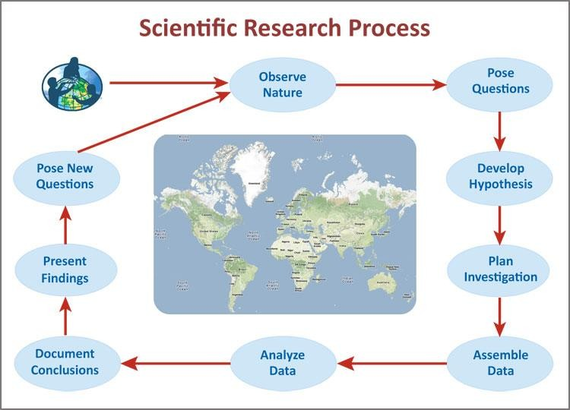
The Process of Scientific Research
9

Slide 10
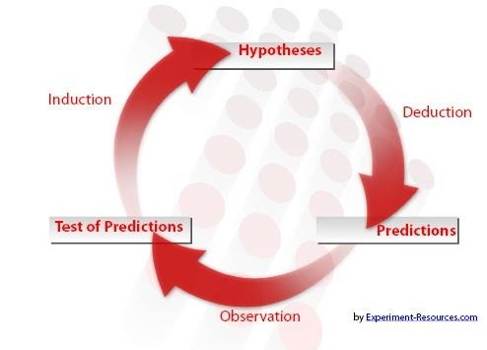
The Process of Scientific Research (2)
https://explorable.com/aims-of-research
10

Slide 11
What is Hypothesis ?
Hypothesis
▹ A clear and testable proposition or predictive statement to answer a research question
Null hypothesis (needed when we have statistical hypothesis testing
No association between variables
11

Slide 12
What is Computer science?
Algorithmic study, investigation an development of computer-related phenomena
Other definitions
The study of phenomena related to computers, Newell, Perlis and Simon, 1967
The systematic study of algorithmic processes that describe and transform information: their theory, analysis, design, efficiency, implementation, and application (ACM-2001)
The study of algorithms, Knuth, 1968
The study of information structures (Wegner, 1968)
Computer Science is the study and management of complexity, Dijkstra, 1969.
The mechanization of abstraction, Aho and Ullman1992

Slide 13
Computer Science Research
We generate data
We collect data
We interpreted data
We search for better way of doing that!

Slide 14
Types of data
Observational
Human observation,
sensors and monitors
surveys
Experimental
Produced through experiments
Reproducible
Casual relations
Derived/compiled
From existing data points or equations
Simulation
Computer algorithm-generated
Test model prediction

Slide 15
Computer Science Research methods
Formal➔ prove facts about algorithms and systems
Experimental: Two phases➔ exploration + evaluation
Build ➔ a new system or new features
Process➔ understand computing tasks
Model and simulate

Slide 16
A 14-step Process:
Choose a problem
Review the literature
Evaluate the literature
Be aware of all ethical
issues
Be aware of all cultural issues
State the research
question or hypothesis
Select the research
approach
Determine how the variables are going to be measured
Select a sample
Select a data collection method
Collect and code the data
Analyze and interpret the
data
Write the report
Disseminate the report
See more : http://www.humankinetics.com/excerpts/excerpts/steps-of-the-research-process
8

Slide 17
Qualitative vs. Quantitative research
Qualitative Quantitative
▸ The aim of qualitative analysis is a complete detailed description.
▸ The design emerges as the study unfolds
▸ Researcher is the data gathering instrument.
▸ Data is in the form of words (interviews), pictures (videos), or objects (artifacts).
▸ In quantitative research we classify features, count them, and construct statistical models in an attempt to explain what is observed.
▸ All aspects of the study are carefully
designed before data is collected.
▸ Researcher uses tools (questionnaires or equipment) to collect data.
▸ Data is in the form of numbers and
statistics.
Quantitative data is more efficient, able to test hypotheses, but may miss contextual data.
▸ Qualitative data is more rich, ▸
time consuming, and less
able to be generalized.

Slide 18
Part II
Scientific Writing

Slide 19
A scientific experiment is not complete until the results have been published and understood.
A scientific paper is a written and published report describing original research results.

Slide 20
What is Scientific Writing
The purpose of scientific writing is to communicate new
scientific findings
Thus it has to be clear, simple and well ordered communication to transmit new scientific findings
Scientific writing must use proper English which gives the
sense in the fewest short words

Slide 21
What is the structure of a scientific paper?
All scientific papers have the same general format. They are divided into distinct sections and each section contains a specific type of information.
The number and the headings of sections may vary among journals, but for the most part a basic structure is maintained.
Because scientific papers are organized in this way, a reader knows what to expect from each part of the paper, and they can quickly locate a specific type of information.

Slide 22
What is the structure of a scientific paper?
Typically, scientific papers are comprised of the following parts:
Title
Abstract
Introduction
Methods
Results
Discussion & Conclusion
Acknowledgments
References

Slide 23
TITLE
The title will help you to determine if an article is interesting
or relevant for your project.
Well-written titles give a reasonably complete description of the study that was conducted, and sometimes even foreshadow the findings. Included in a title are the species studied, the kinds of experiments performed, and perhaps a brief indication of the results obtained.

Slide 24
ABSTRACT
Abstracts provide you with a complete, but very succinct
summary of the paper.
An abstract contains brief statements of the purpose, methods, results, and conclusions of a study.
Abstracts are often included in article databases, and are
usually free to a large audience.
Thus, they may be the most widely read portions of scientific
papers.

Slide 25
INTRODUCTION
You will find background information and a statement of the
author's hypothesis in the introduction.
An introduction usually describes the theoretical background, indicates why the work is important, states a specific research question, and poses a specific hypothesis to be tested.

Slide 26
METHODS
The methods section will help you determine exactly how the
authors performed the experiment.
The methods describes both specific techniques and the overall experimental strategy used by the scientists.
Generally, the methods section does not need to be read in detail. Refer to this section if you have a specific question about the experimental design.

Slide 27
RESULTS
The results section contains the data collected during
experimentation.
The results section is the heart of a scientific paper.
In this section, much of the important information may be in
the form of tables or graphs.
When reading this section, do not readily accept an author's statements about the results.
Rather, carefully analyze the raw data in tables and figures to
draw your own conclusions.

Slide 28
DISCUSSION & CONCLUSION
The discussion section will explain the authors interpret their data and how they connect it to other work.
Authors often use the discussion to describe what their work suggests and how it relates to other studies.
In this section, authors can anticipate and address any possible objections to their work.
The discussion section is also a place where authors can suggest areas of improvement for future research.

Slide 29
ACKNOWLEDGMENTS
The acknowledgments tell you what people or institutions (in
addition to the authors) contributed to the work.
In reading the acknowledgments, you can see what sources provided financial support for the study. You might want to know an industry group or the federal government funded the study.

Slide 30
Essential Parts of a Scientific paper
Title: Describe concisely the core contents of the paper
Abstract: Summarize the major elements of the paper
Introduction: provide context and rationale for the study
Literature review: surveys scientific articles, books, journals, dissertations & other sources relevant to the research question.
Materials: Describe the experimental design so it is reproducible
Methods: Describe the experimental procedures
Results: Summarize the findings without interpretation
Discussion: Interpret the findings of the study
Summary (Conclusion): Summarize the findings
Acknowledgement: Give credit to those who helped you
References: List all scientific papers, books and websites that you cited

Slide 31
LITERATURE CITED (References)
This section provides the sources cited throughout the
paper.
This section offers information on the range of other studies cited.
The literature cited section is also helpful for generating a
list of background reading on the topic under study.

Slide 32
1. WHAT IS A literature review(LR)?
The literature represents an on-going scholarly conversation
A literature review “reviews” – looks again – at what others have said, done and found in a particular area
In fact, a literature review is performed on many rounds.

Slide 33
Sources of Literature (1)
1) Journal articles:
these are good sources, especially for up-to-date
information.
They are frequently used in literature reviews because they
offer a relatively concise, up-to-date format for research.
Depending on the publication, these materials may be refereed materials.

Slide 34
Sources of Literature (2)
What about Non-refereed Journals?
▸ Non-refereed materials such as Trade Journals, or magazines use less precise standards of screening prior to publication.
▸ Non-refereed materials may not be checked as intensely as refereed materials, but many can still be considered useful, although not for scientific literature and research.

Slide 35
Sources of Literature (cont.)
2) Books:
remember that books tend to be less up-to-date, as it takes
longer for a book to be published than for a journal article.
They are still likely to be useful for including in your literature review as they offer a good starting point from which to find more detailed and up-to-date sources of information.

Slide 36
Sources of Literature (cont.)
3) Conference proceedings:
these can be useful in providing the latest research, or research that has not been published.
They are also helpful in providing information about people in different research areas, and so can be helpful in tracking down other work by the same researchers.

Slide 37
Sources of Literature (cont.)
4) Government/corporate reports:
Many government departments and corporations commission carry out research.
Their published findings can provide a useful source of
information, depending on your field of study.

Slide 38
Sources of Literature (cont.)
5) Thesis and dissertations: can be useful sources of information.
However there are disadvantages:
they can be difficult to obtain since they are not published, but are generally only available from the library or interlibrary systems
the student who carried out the research may not be an experienced researcher and therefore you might have to treat their findings with more caution than published research.

Slide 39
Sources of Literature (cont.)
5) Thesis and dissertations:
A PhD thesis in the science is supposed to present the
candidate’s original research i.e. it is a scientific paper
Unlike the scientific paper, the thesis may describe more than one topic, and it may present more than one approach to some topics.
The thesis may present all or most of the data obtained in the student’s thesis related research.
Thus it is more involved and longer than a scientific paper.

Slide 40
Sources of Literature (cont.)
6) Internet: the fastest-growing source of information is on the
Internet.
bear in mind that anyone can post information on the Internet so the quality may not be reliable
the information you find may be intended for a general audience and so not be suitable for inclusion in your literature review (information for a general audience is usually less detailed).

Slide 41
Assignment

Slide 42
What is the quality of the papers I have collected?

Slide 43
Template- Title evaluation of my papers
# | Title | Length | No Redundancy | Specificity | Syntax | Keywords | Total
1
2
3
4
5

Slide 44
Template- Abstract evaluation of my papers
# | Title | Single Paragraph | Fewer than 250 words | No Citations | Abbreviations | Consistency | Past Tense | Total
1
2
3
4
5

Slide 45
General Criteria:
Paper # | Hypothesis | Aim | Why is this paper important? | Not too many details | Method of investigation | State the results | Final score
1 | 0 | 0 | 1 | 1 | 0 | 1 | 3
2 | 1 | 1 | 1 | 0 | 1 | 1 | 5
3 | 1 | 1 | 1 | 1 | 0 | 0 | 4
4 | 1 | 1 | 1 | 1 | 1 | 1 | 6
5 | 0 | 1 | 1 | 1 | 1 | 1 | 5
6 | 0 | 1 | 1 | 1 | 1 | 1 | 5
7 | 0 | 1 | 1 | 1 | 1 | 1 | 5
8 | 0 | 1 | 1 | 1 | 1 | 1 | 5
9 | 0 | 1 | 1 | 0 | 1 | 1 | 4
10 | 1 | 0 | 1 | 1 | 1 | 1 | 5
11 | 0 | 1 | 1 | 0 | 1 | 1 | 4
12 | 1 | 1 | 1 | 0 | 1 | 1 | 5

Slide 46
Accuracy | No abbreviations | Informative | Good length | Final score
1 | 1 | 1 | 1 | 4
1 | 1 | 1 | 0 | 3
1 | 0 | 0 | 0 | 1
1 | 1 | 1 | 0 | 3
1 | 0 | 1 | 1 | 3
1 | 1 | 0 | 0 | 2
1 | 0 | 1 | 0 | 2
1 | 1 | 0 | 0 | 2
1 | 1 | 1 | 1 | 4
Title of my term paper-Example
Student #1
5G Wireless Communication and Health Effects
Big data privacy issues
Ethical hacking ethics
Student #2
5G Networks and IoT
Importance of network security cryptography encryption
Ethical artificial intelligence and machine learning
Student #3
Home networking environment
Research on how AI and deep learning are changing the healthcare industry
ETHICAL HACKING TECHNIQUES WITH PENETRATION TESTING
Final topic: ETHICAL HACKING TECHNIQUES WITH PENETRATION TESTING

Slide 47
Paper | Less than 250 | 1 paragraph | Past tense for own work | long words abbreviations | No citations | Final score
1 | 1 | 1 | 0 | 1 | 1 | 4
2 | 1 | 1 | 0 | 0 | 0 | 2
3 | 1 | 1 | 1 | 1 | 1 | 5
4 | 1 | 1 | 0 | 0 | 1 | 3
5 | 1 | 1 | 0 | 1 | 1 | 4
6 | 1 | 1 | 0 | 0 | 0 | 2
7 | 1 | 1 | 1 | 1 | 0 | 4
8 | 0 | 1 | 0 | 1 | 0 | 2
9 | 1 | 1 | 1 | 1 | 0 | 4
Scoring the abstracts

Slide 48
To be continued

